Slide 1
Ministry of Research&Technology Higher Education
University of Gadjah Mada
British Council
NATIONAL ENERGY CHALLENGES
Tutuka Ariadji
Faculty of Mining and Petroleum Engineering-ITB
Jogyakarta
March 4, 2015

Slide 2
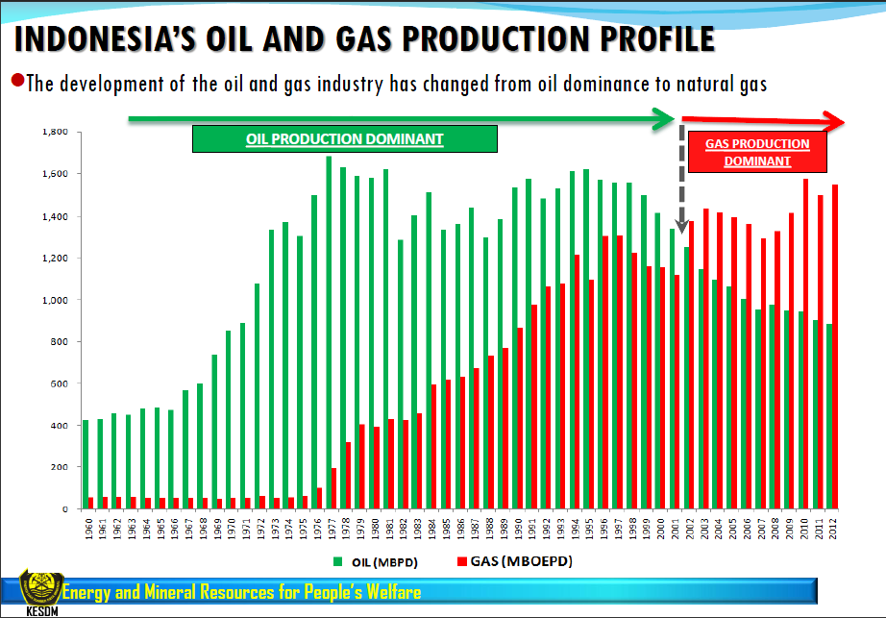

Slide 3
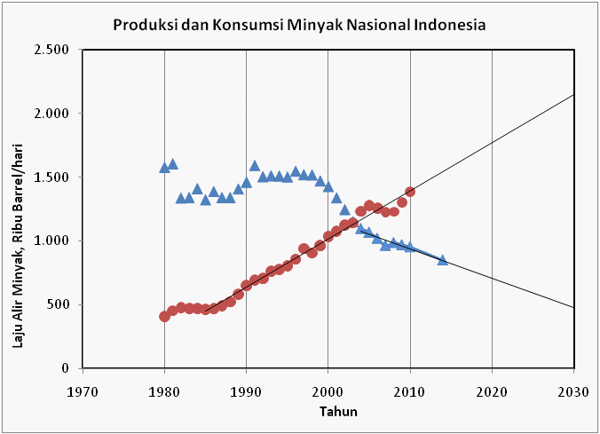
National Production versus Consumption: if no significant New Fields, Ehanced Oil Recovery
Consumption
Production

Slide 4
Oil Business
History:
Export 2004-2011: 380,000 Barrel Oil Per Day (BOPD)
Average National Oil Production: 900,000 BOPD
Import Crude Oil : 300,000 BOPD (data BPS),
Crude Oil for National Needs: 820,000 BOPD
National Oil Consumtion 2013 : 1,500,000 BOPD, thus, lack of 650,000-700,000 BOPD.
In 2030, if no significant New Fields, Ehanced Oil Recovery, National Oil Production: 500,000 BOPD, the National Oil Consumption is 2,1 million BOPD, thus it needs 1,6 million BOPD.

Slide 5
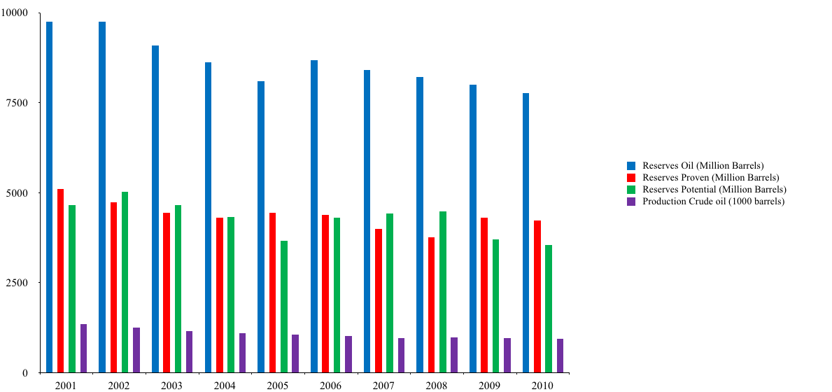
National Oil Reserves: Constantly Decreases

Slide 6
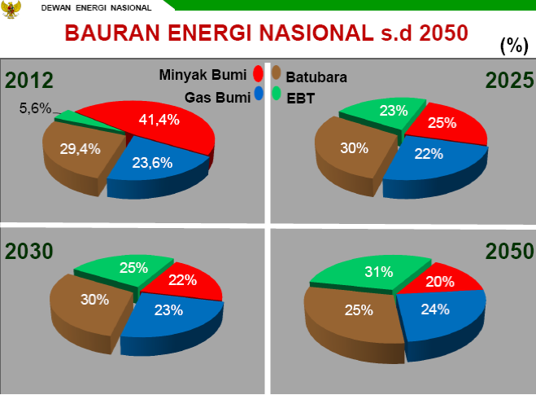
Indonsia Energy (Mixed) 2014-2050

Slide 7
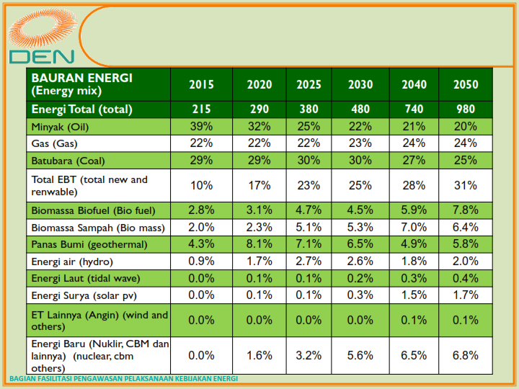
Energy Mixed Composition

Slide 8
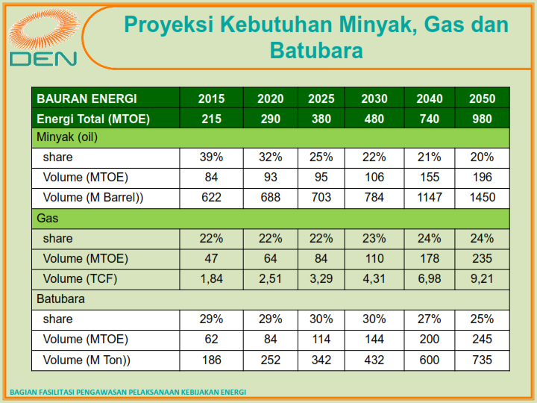
Fossil Energy Consumption

Slide 9
ITB Research and Projects on Energy
Center for Research on Energy Policy (1980)
Studies:
Subsurface Survey, Mapping, Modelling (biggest)
Oil & Gas Field Development Studies
Coal: Steam Power Generator, Gassification, Design Support (Soil, Ocean, Electrical)
New Energy: Detail Design Power Generator using Garbage, Feasibilty Solar Power, Microhydro Power
Studies and Products:
Solar Cell: SOLARE
EOR Chemicals: Surfactant
New Energy: CPO Fuel for Power Generator

Slide 10
Research Consortium: OGRINDO
Oil and Gas Recovery for Indonesia
Website http://ogrindo.tm.itb.ac.id
On Going Research Topics:
EOR Screening
Waterflooding
Polymer
MEOR
Sand Control
Surfactant
CO2
Production Optimization
Nitrogen
Current Members:
  BP Migas (Supporting)
  Chevron Pacific Indonesia
  CNOOC, SES Ltd.
  PT. Pertamina (Persero)
  TOTAL E&P INDONESIE
  INDOSPEC

Slide 11
terimakasih

