Slide 1
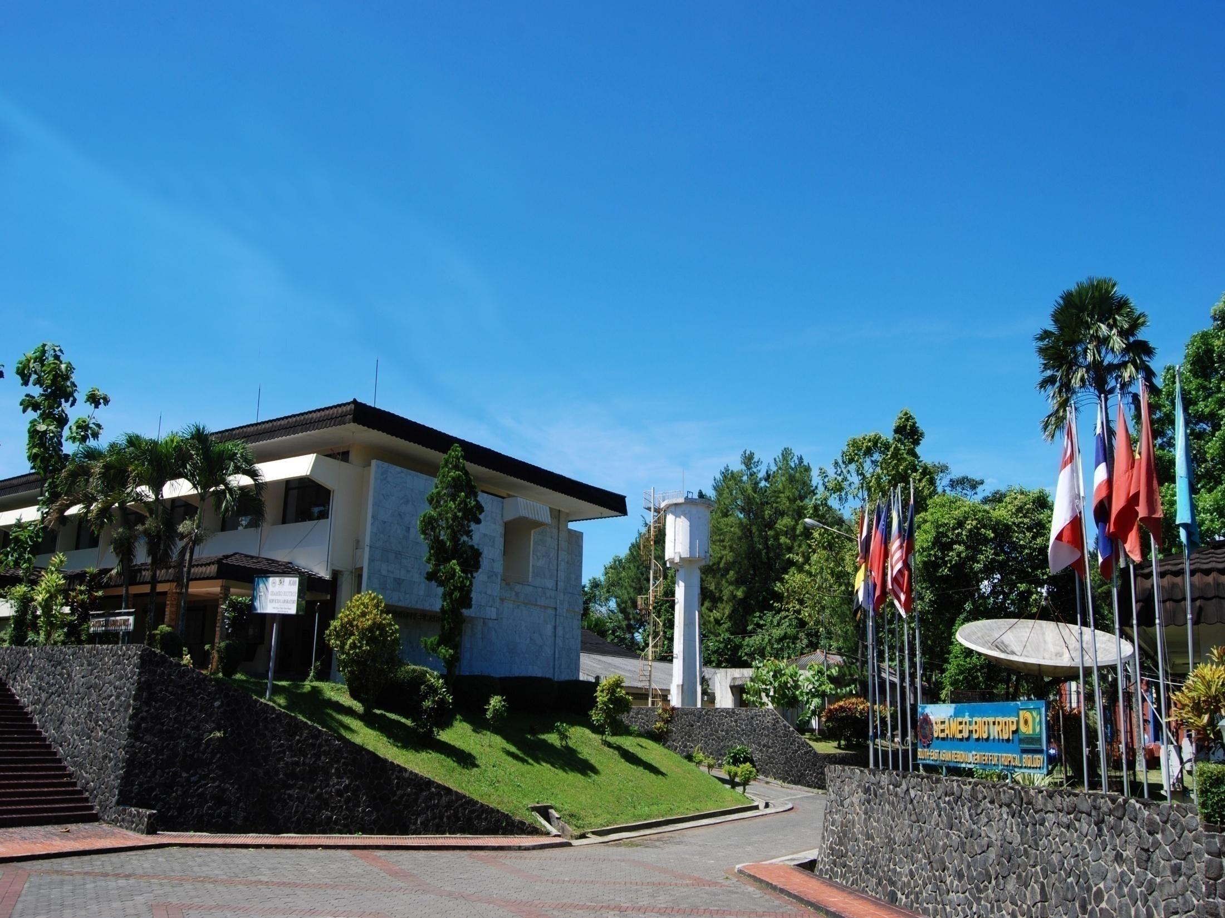

SEAMEO BIOTROP’s
Programs and Activities on Innovation & Entrepreneurship for the Next Generation
Jess C. Fernandez, PhD

Slide 2
Presentation Outline
BIOTROP Vision-Mission & Program Thrusts
BIOTROP Programs and Activities related to Innovation and Entrepreneurship
Some BIOTROP Research Products

Slide 3
BIOTROP’s Vision & Mission
Vision:
“A Leading Centre in enhancing and promoting the real values of tropical biology in Southeast Asia.”
Mission:
“To provide scientific knowledge and capacity building
in conserving and managing tropical biology sustainably
for the well-being of communities and the environment
of Southeast Asia”
“Enhancing and Promoting the Real Values of Tropical Biology in Southeast Asia”

Slide 4
BIOTROP’s Program Thrusts
1.
Tropical Biology for Community Welfare
To help communities decide, plan, and take action to meet their own needs and solve problems concerning the biological resources around them for their existence in a judicious and sustainable way.
Topics Covered:
Food and Feed Security and Safety
Bio-energy Development
Tropical Pests & Diseases Management
Value Adding in Natural Products
Biotechnology
“Enhancing and Promoting the Real Values of Tropical Biology in Southeast Asia”

Slide 5
BIOTROP’s Program Thrusts
2.
Tropical Biology for Environmental Integrity
Geared towards working with relevant institutions in finding ways to help ecosystems recover their original functioning and ensure environmental sustainability.
Topics Covered:
Biodiversity Conservation & Management
Landscape Restoration
Management of Tropical Ecosystem
Functions and Services
Ecosystems Health Monitoring
“Enhancing and Promoting the Real Values of Tropical Biology in Southeast Asia”

Slide 6
BIOTROP’s Programs & Activities
PhD Thesis Grants Program
Joint Research Program
Private Sector Research Engagement
Student Internship and On-the-Job Training
Knowledge and Technology One-Stop Shop
“Enhancing and Promoting the Real Values of Tropical Biology in Southeast Asia”

Slide 7
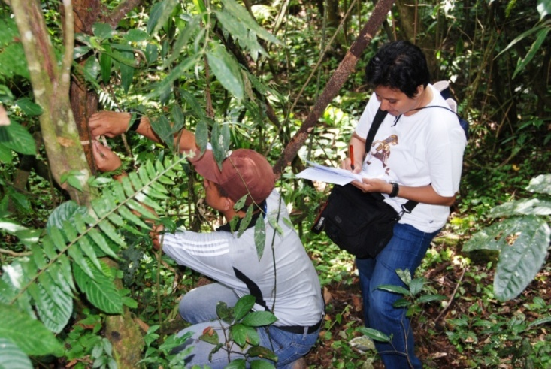
PhD Thesis Grants Program
To increase the number of qualified human resources in universities and government agencies to contribute to Indonesia’s development in the area of tropical biology and natural resources management.
Has benefited a total of 34 PhD
students from 14 universities
and research institutions in
Indonesia since 2011
BIOTROP scientists serve as mentors where appropriate
“Enhancing and Promoting the Real Values of Tropical Biology in Southeast Asia”

Slide 8
Examples of PhD Thesis Supported
Utilization of Betung Bamboo for Bioethanol Production Using Biological-Microwave Pretreatment
Quality Enhancement of Particle Board from Jatropha Fruit Hulls
Combined Antimicrobial Effect of Ginger (Zingiber officinale var. Rubrum) and Galangal (Alpinia galanga L. Willd.) Essential Oils Against Food borne Pathogen and Food Spoilage Bacteria in Food Model Media
Improving Catfish (Clarias sp.) Broodstock Reproduction Quality Through Combination with Microalgae Spirulina and Hormone
Effect of Kebar Grass (Biophytum petersianum Klotzsch) Extract on Aspergillus Flavus Growth and Aflatoxin B1 Production in Food Model System
Study on Pegagan (centella asiatica) as Contraceptive Agent and Its Recovery Enhancement by Purwoceng (pimpinella alpine Molk)
Study of Biodiversity and Development of Aphids Identification Key in West Java
“Enhancing and Promoting the Real Values of Tropical Biology in Southeast Asia”

Slide 9
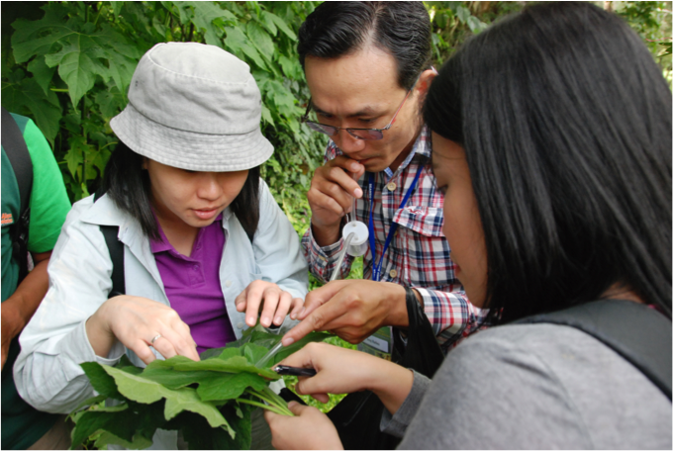
Regional Joint Research Program
Launched in 2013 on counter parting scheme & in the context of South-South collaboration
To promote scientific collaborations among government research and academic institutions in addressing common development concerns among Southeast Asian countries along the program thrusts of SEAMEO BIOTROP
Involvement of graduate students

Slide 10
Regional Joint Research Program
Two grantees in 2014:
(1) Assessing the Biodiversity and Antimicrobial Activities of
Fungal Leaf Endophytes Associated with Philippine and
Indonesian Mangroves
Research proponents: Institut Pertanian Bogor (IPB),
Indonesia and University of Sto. Tomas, Philippines
(2) Biodiversity and Antiproliferation Activities of
Indonesian Java Chili, Piper retrofractum Vahl, Against
Breast Cancer Cells (MCF-7)
Research proponents: IPB and University of Sabah
Malaysia

Slide 11
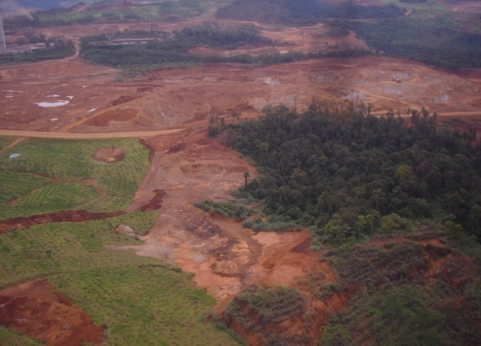
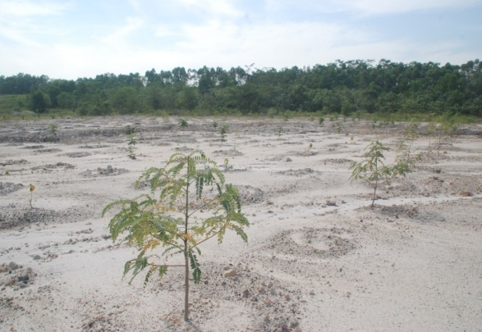
Private Sector-Academe Research Engagement
Project on “Transforming Degraded
Lands into Productive Landscape” under the
British Council support
Bukit Asam Coal Mining Company as project site
for testing technologies from 2 UK universities,
7 Indonesian universities and SEAMEO BIOTROP
Towards establishing a Network of Research
Excellence for Mine Reclamation in Southeast
Asia
Will involve student and faculty exchanges

Slide 12
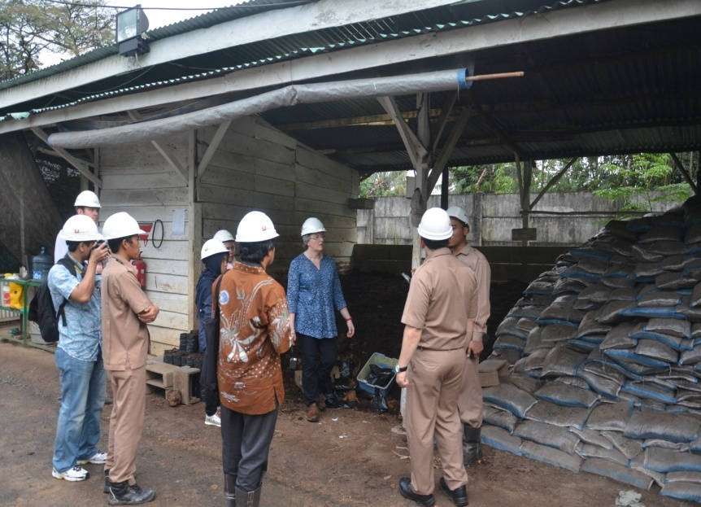
Private Sector-Academe Research Engagement
Compost using aquatic weeds abundant in the mining area has been produced by a post graduate student and now being used by the company because the technique is simple and the quality is very good to increase seedling growth
Partner Experts from UK:
Prof Morag McDonald, Dr Paula Robert,
Dr Graham Bird from Bangor University
Dr William Timothy Perkins from
Abryswyth University

Slide 13
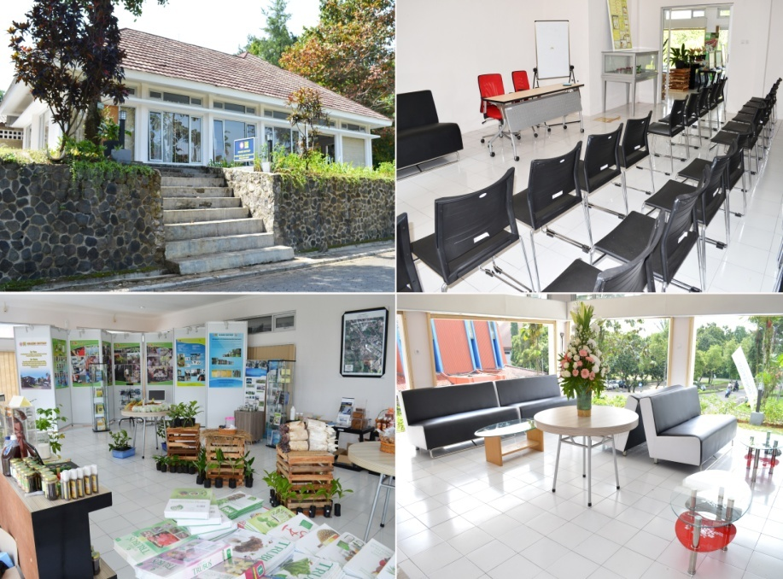
Knowledge and Technology
One-Stop Shop
Showcases technologies & knowledge products of BIOTROP and partner-institutions for public consumption.
Also aims to promote better understanding and appreciation of the real values of tropical biology
Free technical consultations
with the Centre’s scientists
and research staff on a
scheduled basis
“Enhancing and Promoting the Real Values of Tropical Biology in Southeast Asia”

Slide 14
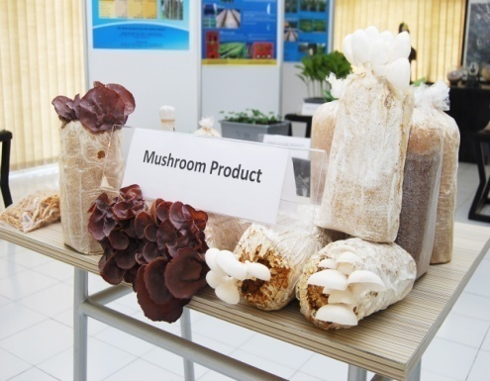
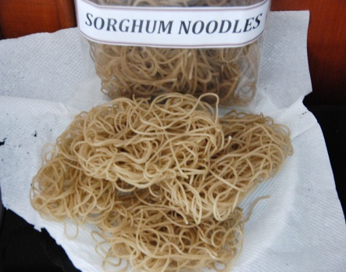
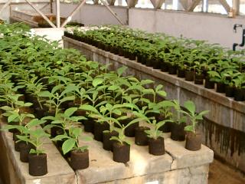
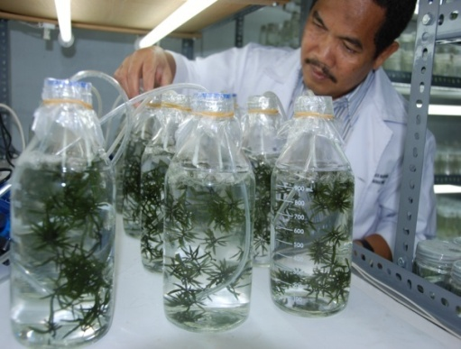
Some BIOTROP
Research Products

Slide 15
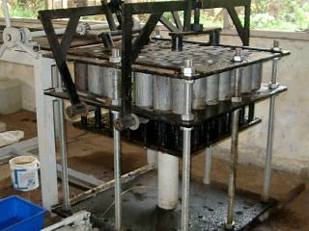
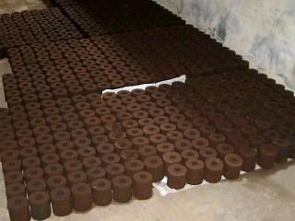
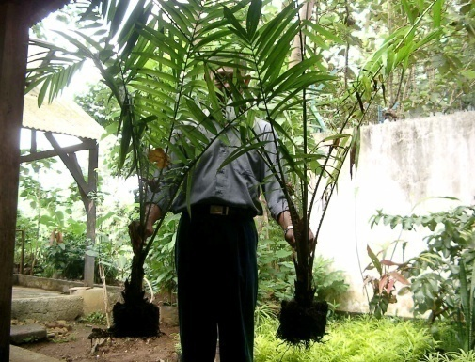
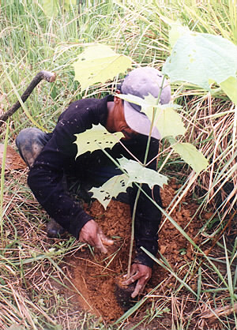
Organic Nursery Blocks
Organic potting medium consisting of coco husk and compost that is more eco-friendly to replace polybags
Easy to handle as seedlings can be directly transplanted in the soil
Being promoted in plantation areas and for restoration in ex-mining sites
“Enhancing and Promoting the Real Values of Tropical Biology in Southeast Asia”

Slide 16
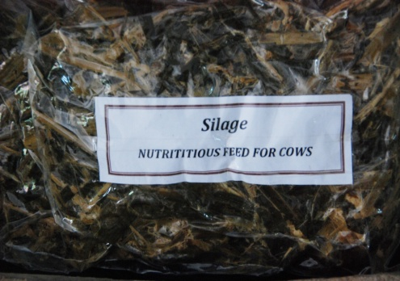
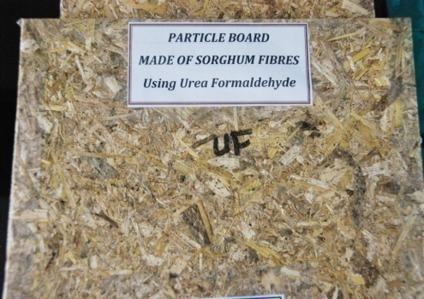
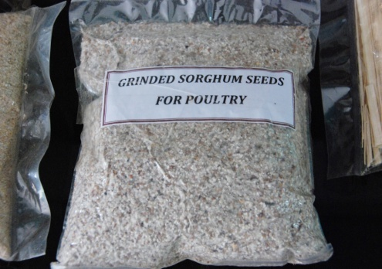
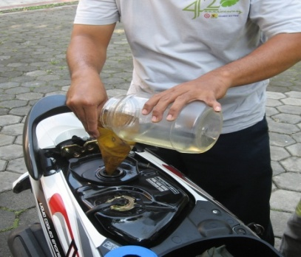
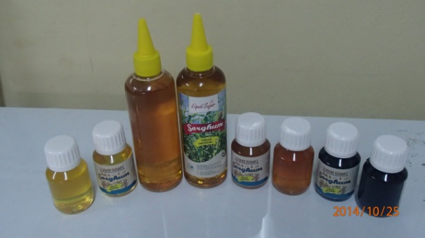
Sorghum By-Products
5 Fs of Sorghum
Food
Feed
Fiber
Fuel
Fertilizer
“Enhancing and Promoting the Real Values of Tropical Biology in Southeast Asia”

Slide 17

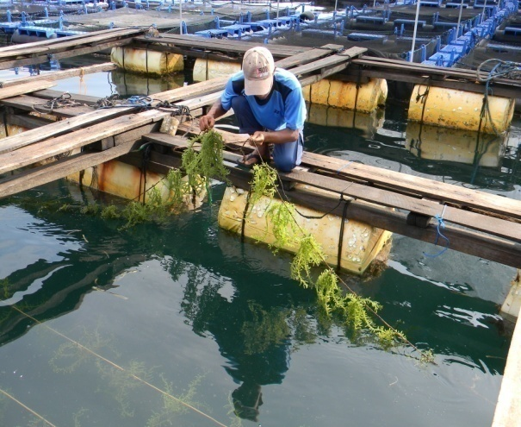
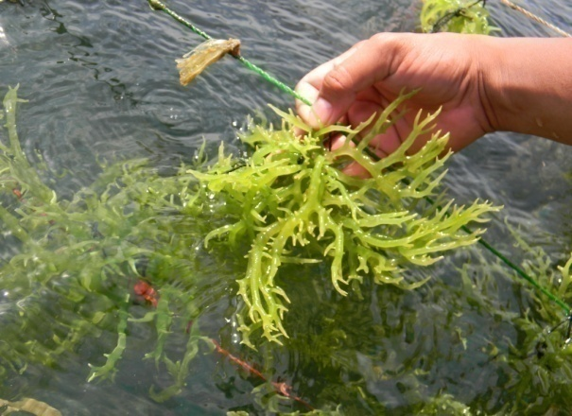

Tissue-cultured Seaweed
First in Indonesia for Cottonii seaweed
MoU with the National Seaweed
Center and the Ministry of Marine
Resources to maintain stocks for
continued supply to farmers
“Enhancing and Promoting the Real Values of Tropical Biology in Southeast Asia”

Slide 18
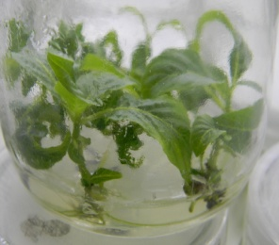
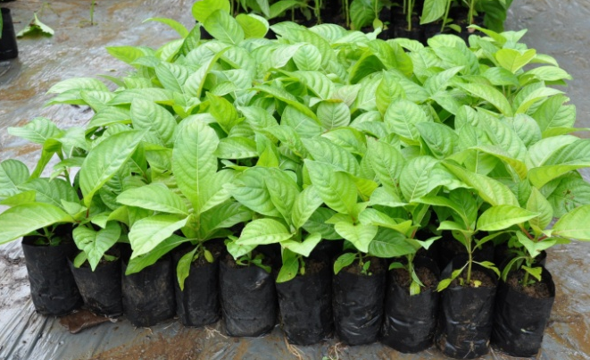
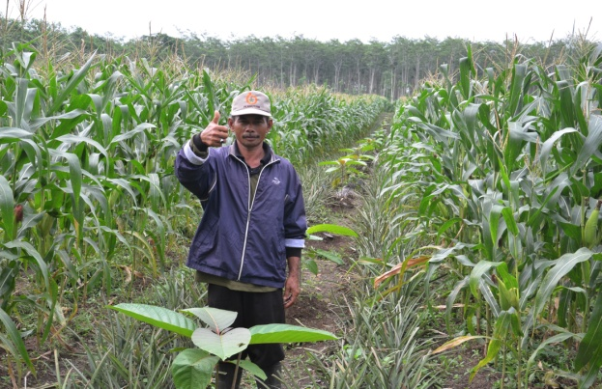
Plantation Tree Species
Teak, Albizia, Jabon (Kadam), Samama (red Kadam), iron
wood, Eucalyptus, and Acacia mangium
Approximately, 2 million teak seedlings have been planted
in 20 provinces in Indonesia since 2000; expected to
generate US$1M after 10 years at 50% survival rate
New and more entrepreneurs have emerged due to these
products
“Enhancing and Promoting the Real Values of Tropical Biology in Southeast Asia”

Slide 19
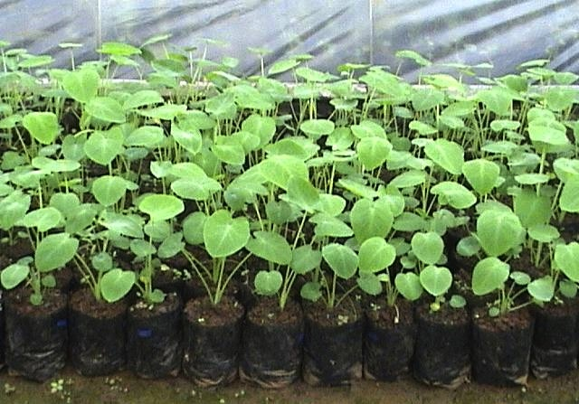
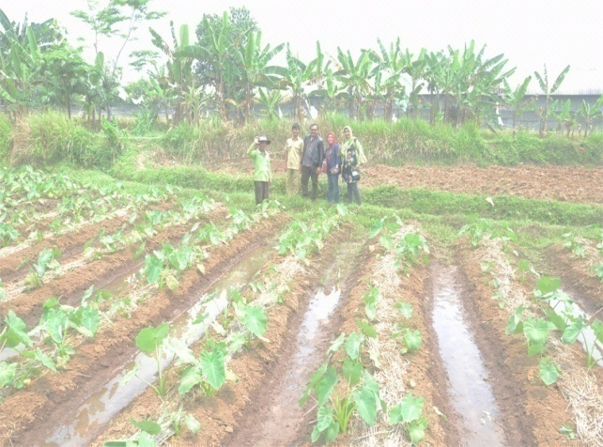
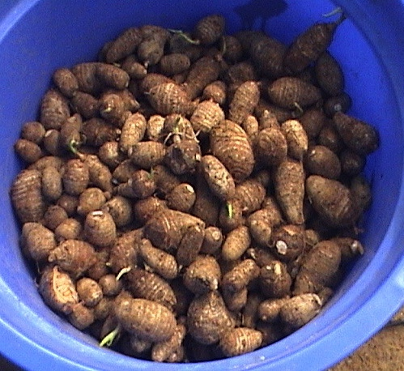
Satoimo (Japanese Taro) Plant
Faster harvesting period (5 mos) & high
yielding (10-50 tons/ha)
Adopted by farmers & entrepreneurs in
10 provinces in Indonesia
Collaborations with Bantaeng District
(for export as food source), Malaysian
Company (for collagen production) and
Cihideiung Ilir local government in Bogor
(for livelihood generation)
“Enhancing and Promoting the Real Values of Tropical Biology in Southeast Asia”

Slide 20
Thank you for your attention.
www.biotrop.org

