Slide 1
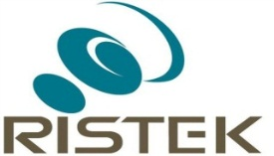



Lost in Translation:
Enabling Economic Development through Academia-Business and Government Linkages
Dr. Hargo Utomo, MBA., M.Com
Director of Business Development and Incubation
Universitas Gadjah Mada
Email: hargo_utomo@ugm.ac.id
Yogyakarta, March 4, 2015

Slide 2
Outline
Introduction
Basic Questions and Principles
Major “clouds of development”
Illustrative Case Studies
Conclusions and further agenda

Slide 3
Introduction

Slide 4
Major Issues
Triple helix model: an ideal concept, but relatively minimum fruitful stories that can be delivered in the implementation stage.
It is a long-standing issue especially in the area of economic development, industrial organization, and strategic management.
It applies a contingency approach and sometime require a modified action to implement and make it happen across the board.

Slide 5
Organizational Challenges
The adoption of technological innovation enables new ways of knowledge creation and its applications to the society.
The main challenge is how to build strategic alignment amongst parties (academia, business, and government) involved in the development of the proposed agenda.
The acceptance of transformational leadership along with strong commitment to implement the proposed agenda will determine positive impacts to society.

Slide 6
Basic Questions and Principles

Slide 7
Basic Questions
How to build trust and strong commitment amongst parties to implement common strategic goals?
How to reduce the phenomenon of “ego centric” amongst parties involved in the development and commercialization of innovation?
How to accelerate innovation leading to economic development?

Slide 8
Compromising Mandate
University mandate: teaching, research, and community development/services;
Business mission: financial return as the bottom-line for capital investment and commercialization of the innovation;
Government mandate: support to development that lead to welfare society.

Slide 9
“The Three Pillars”
Shared Vision
Accept Common Goals
Committed to Strategic Action

Slide 10
Major Clouds of Development

Slide 11
Clouds of Development
Health and Pharmacy
Agriculture
New and Renewable Energy
Manufacturing and IT
Heritage, Art & Culture Sustainable Management

Slide 12
Business Ecosystems and Strategic Innovation
Industry-driven research
Research funding
Property rights
Standardization and certification
Seed capital – Angel Investor
Venture capital
Mentorship for start-ups business
Academia and business networking

Slide 13
Illustrative Cases

Slide 14


Socio-Entrepreneur: Tea Producers
Academic research at the University to find the best quality of tea leafs and the application of sustainable production.
Attractive to long-term profitable investment for business in Yogyakarta and Central Java.
Facilitation of local government to get community involvement through participation in small-holder plantations.

Slide 15





Herbal Products: Waiting for Commercial License 2015

Slide 16
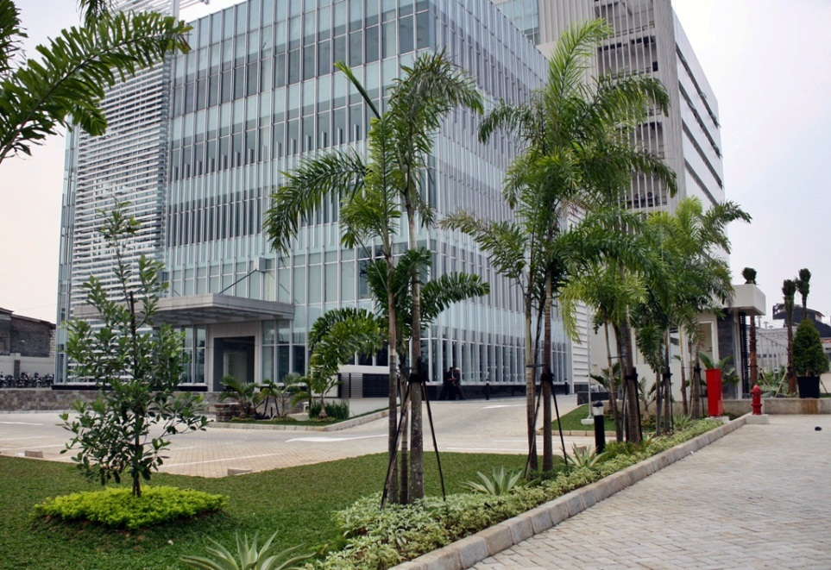

Building Infrastructure
Building physical infrastructure for innovation center and academic activities.
A collaborative model of academia and industry to provide infrastructure for education.
The first model of “satellite” campus in Indonesia.

Slide 17
Proposal:
A consortium study on methane hydrate resources in Indonesia:
Preparing for exploration-exploitation
Ditjen Migas
SKK Migas
Formulation Distribution deposit characteristics
- Geoscience
- Physics & Chemistry
- Geotechnics & Engineering
University
Lembaga Penelitian
Perusahaan MIGAS
Data
Sample
Strategy Eksploration
Eksploitation
Oil & gas Companies
Regulation
Universities
UGM
Other Uni
Gov Institutions
Lemigas
BPPT/LIPI
Badan Geologi
Oli & Gas Companies(R&D):
Pertamina UTC
Other companies
Courtesy: Ferdian, Geology UGM, 2015

Slide 18
Conclusion and Further Agenda

Slide 19
Conclusions: Key Elements for Success
The triple helix is an ideal model of innovation, but it requires a reliable infrastructure, not only hard infrastructure but also soft infrastructure to succeed.
Improving human resource capability basically is crucial element and it is joint responsibility of academic, business, and the government agency.
Introducing investment incentives, such as ‘tax holiday’ or tax reduction schemes and lower interest rates are the “magnet” of business involvement.
Facilitation to industrial networking on regular basis is a good step to invite participation among parties.

Slide 20
Further Agenda
Bring the industry problems into campus and start doing joint efforts to find solutions and deliver innovative products for the society.
To accelerate innovative products get into the market, University requires to adopt industry-driven research agenda.
Facilitate incentive scheme for start-ups and business development initiatives.

Slide 21
References
Harper, C.J. and Georghiou, L. (2005)., “Foresight in innovation policy: Shared vision for science park and business-university links in a city region”, Technology Analysis & Strategic Management, Vol. 17., No.2., p.147-160.
Johnson, A.H.W. (2007)., “Managing collaborations of engineering management with academia and government in triple helix technology development project: A case example of Precarn from the intelligence systems sector”, Engineering Management Journal, Vol.19., No.2.
Kapoor, R. and Lee, M.J. (2013)., “Coordinating and competing in ecosystems: How organizational forms shape new technology investment”, Strategic Management Journal, Vol. 34., p. 274-296.
Mohan, R.S. (2012)., “Government initiatives for developing technologies in public research institutes through strategic relationship with industry”, Journal of Technology Management for Growing Economies, Vol. 3., No. 1, April., p.79-94.

