Slide 1
Industry-University Infrastructure
Prof. David Taylor
Pro Vice-Chancellor International
University of Huddersfield

Slide 2
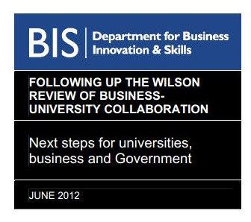
University Strategy and Industrial Strategy
“Universities are an integral part of the skills and
innovation supply chain to business.”
Wilson Review, February 2012
“You get innovation when great universities, leading-edge science, world-class companies and entrepreneurial start-ups come together…It’s all about creative interactions between science and business.”
Rt Hon George Osbourne MP, Chancellor of the Exchequer, November 2012

Slide 3
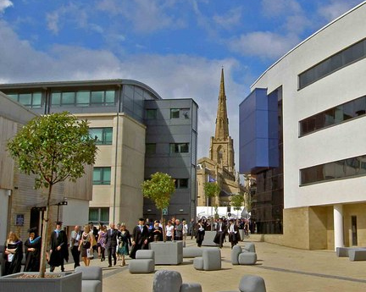
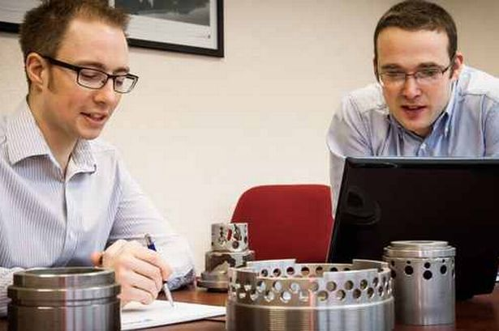
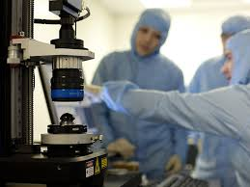
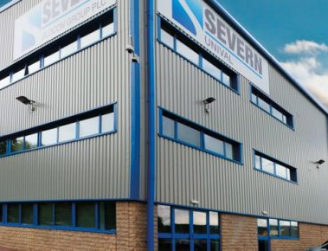
Interactions
UG Work Experience
Graduate Recruitment
Joint courses and CPD
Joint Research and KTP
Laboratory Facilities

Slide 4
Interactions
Twice as likely to achieve a 1st
Graduate Recruitment
Joint courses and CPD
Joint Research and KTP
Laboratory Facilities

Slide 5
Interactions
UG Work Experience
70% return to same company
Joint courses and CPD
Joint Research and KTP
Laboratory Facilities

Slide 6
Interactions
UG Work Experience
Graduate Recruitment
Joint courses and CPD
Staff relationship and funding
Laboratory Facilities

Slide 7
Interactions
UG Work Experience
Graduate Recruitment
Joint courses and CPD
Joint Research and KTP
Scoping new research projects

Slide 8
Interactions
UG Work Experience
Graduate Recruitment
Railways/Turbochargers/Logistics
Joint Research and KTP
Laboratory Facilities

Slide 9
?

Slide 10
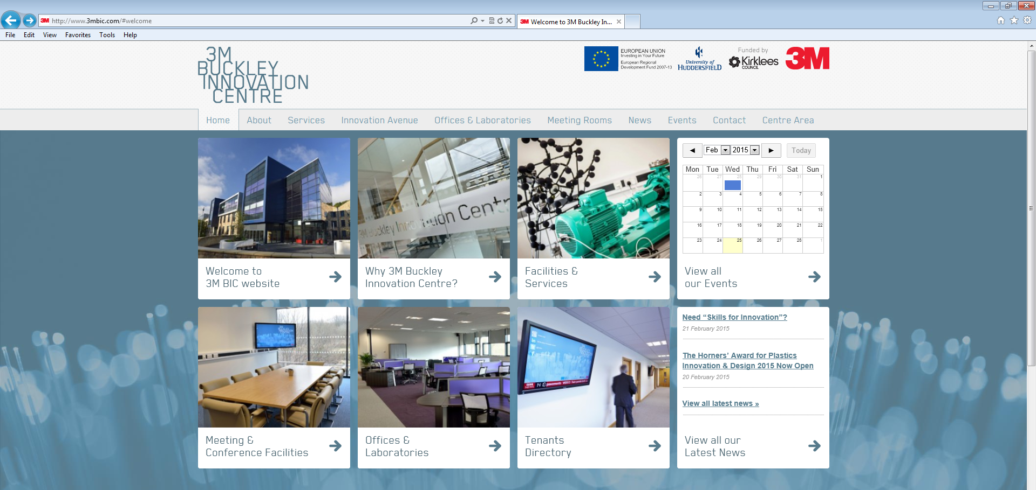
3MBIC www.3mbic.com

Slide 11

3MBIC www.3mbic.com
Buckley Innovation Centre

Slide 12

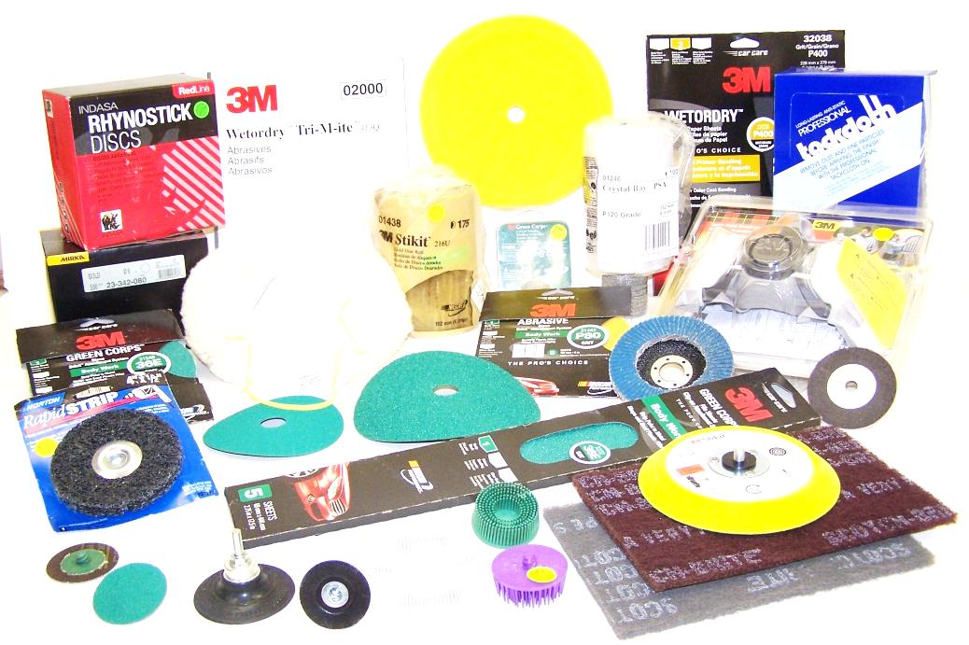
Innovation US multinational
Employs almost 100,000 people
Produces over 50,000 products
$30 Billion sales annually

Slide 13
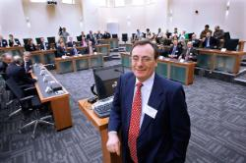
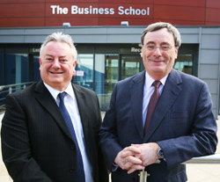
Buckley
Sir George Buckley
CEO of 3M
And an alumnus of the
University of Huddersfield
Commitment to innovation
Sir George Buckley

Slide 14

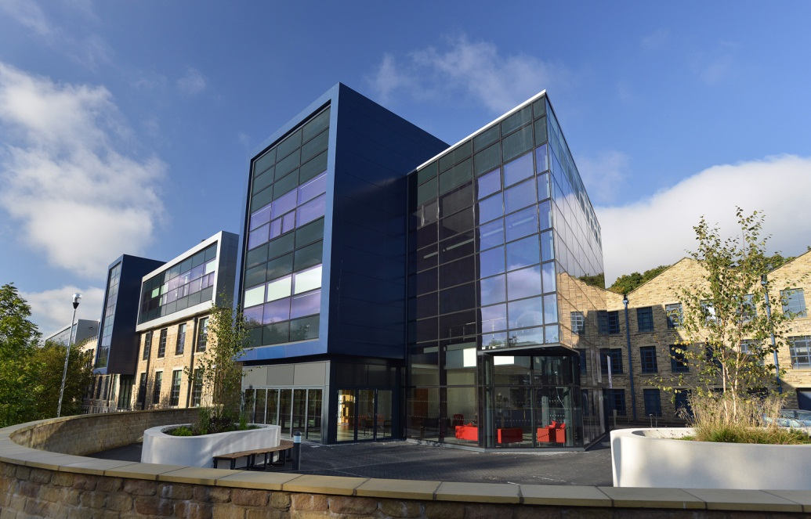
3M Buckley Innovation Centre
Jointly funded £12 million development
Wholly owned subsidiary of University-
business input from 3M
Support for high growth technology businesses

Slide 15
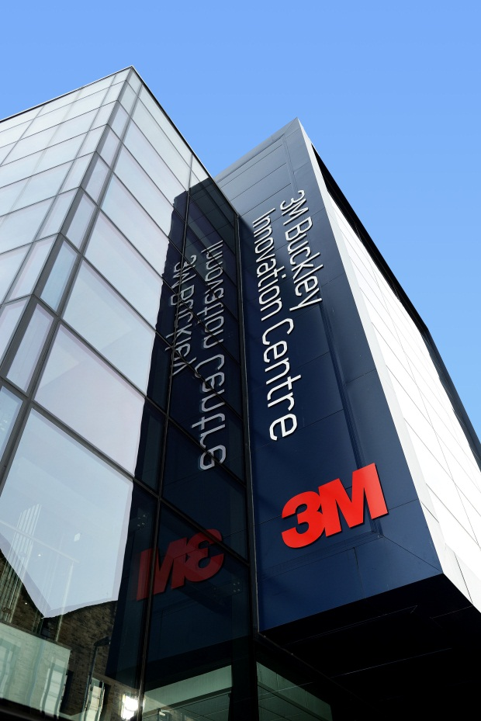

The 3M Buckley Innovation Centre
Home to 70 companies already
Research Group and student spin-outs
New company spin-ins
National bodies

Slide 16
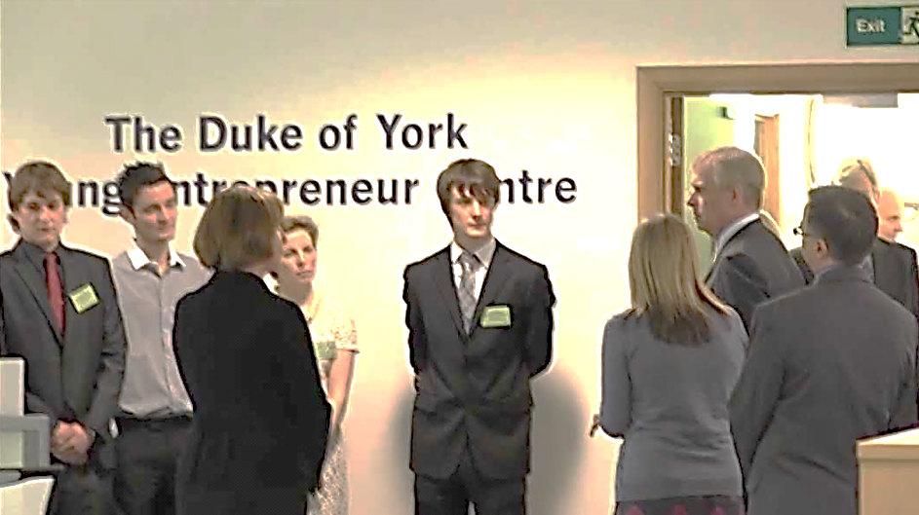
Benefits to a University
Brings business closer to the University
Opportunity to enhance student experience
Intellectual challenges
Impact of research
Potential revenue streams

Slide 17
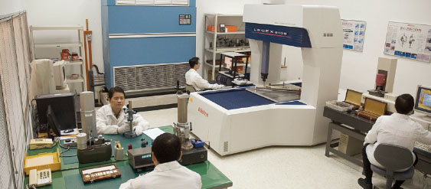
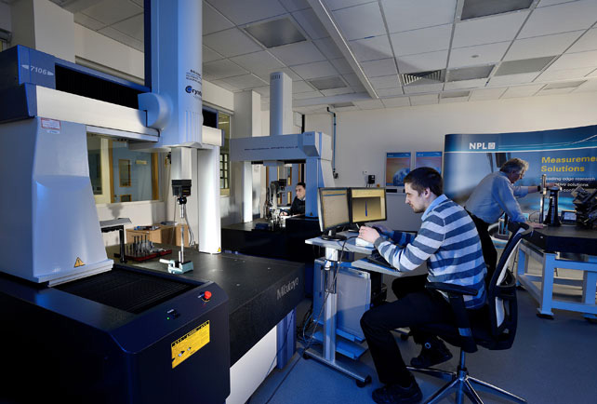
Benefits to Industry
Access to specialist knowledge/equipment
Access to government funding and bid support
Delivery of innovative commercial products
Educators of next generation/Recruitment pipeline
Up to 1000 associate companies + support network

Slide 18
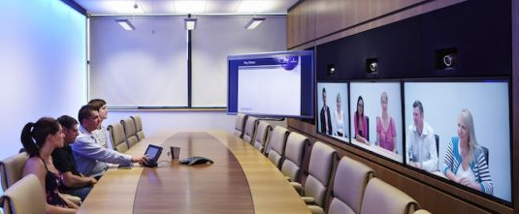
Benefits to the Local Economy
Modernising and diversifying the economy
Inward investment
Creating sustainable jobs
Stimulating economic growth
Attracting overseas trade

Slide 19
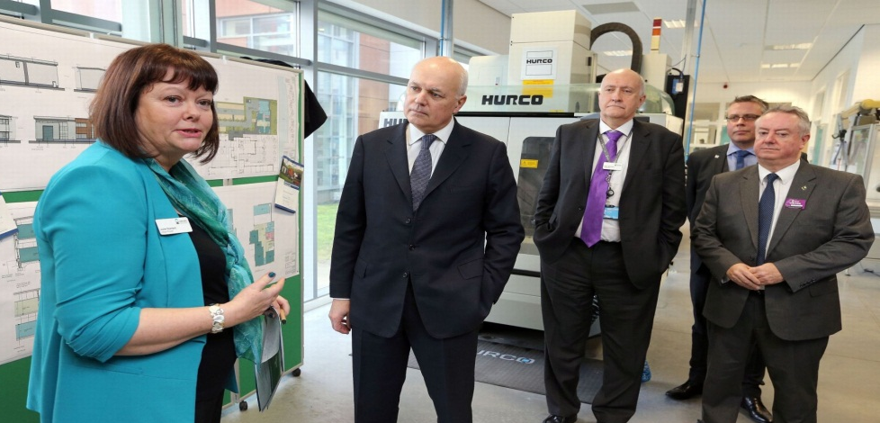
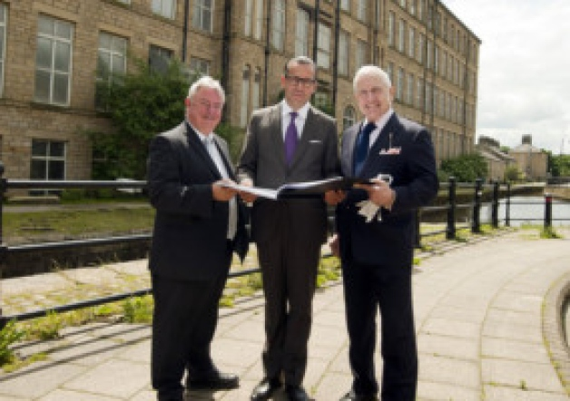
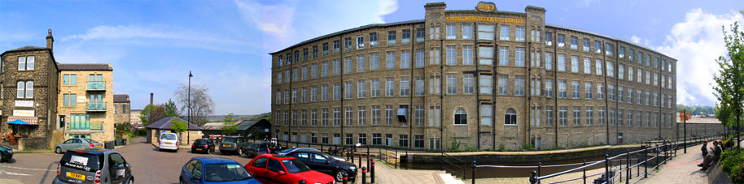
Expansion
Recently announced £3M of additional grow-on space in local Business Park

Slide 20
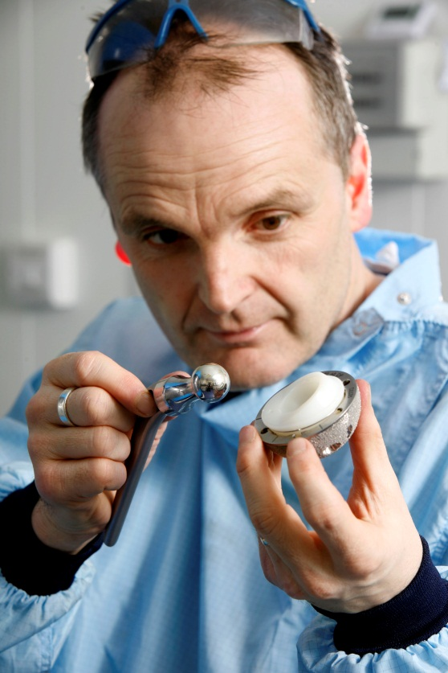
Lessons
Common ground – technologically and physically
Resource sharing
Need for a collective regional vision
On campus, owned by the University – but independent
Students and graduates fuel the relationship

Slide 21
Infrastructure
Universities
The right research infrastructure
- that supports the local and national economy
The right courses
- producing enterprising graduates with research and commercial skills
- with work experience and live-project experience
Industry
Access to shared resources and best practice
Government support, access to funding with bidding support
Access to international graduate talent and market intelligence

