Slide 1


Promoting University-Industry Collaboration
Ocky Karna Radjasa
Diponegoro University

Slide 2
Introduction
Collaboration between universities and industries is critical for skills development (education and training),
the generation, acquisition, and adoption of knowledge (innovation and technology transfer), and
the promotion of entrepreneurship (start-ups and spin-offs).

Slide 3
Indicators for Indonesian University Research Performance
Scientific publication
IPR
Applied technology
Model/Prototype/Design/Art
Teaching books
Staff research participation
Visiting Lecturer
Keynote Speaker
No | Component | (%)
1 | Human resource qualification | 10
2 | Research Center | 10
3 | Staff Research Grant from DGHE | 20
4 | Output | 35
5 | Management of Research Institution | 15

Slide 4
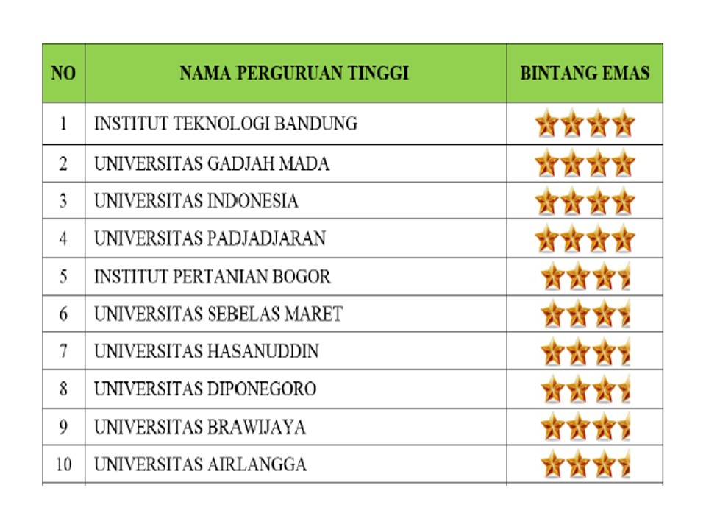
University Research Performance
Per 27 March 2014

Slide 5
Research budget managements based on performance
 | Group of University
 | Mandiri | Utama | Madya | Binaan | Politeknik
Excellent research scheme | 100% | 60% | 35% | 25% | 50%

Slide 6
Triple Helix systems
University
Relationships between components and functions
Government
Industry

Slide 7
A typology of university-industry links, from higher to lower intensity

Slide 8
Strategic Missions
since the 1990s, the strategic mission of universities has moved beyond the tradition of teaching and research toward a “third mission” related to better addressing the needs of industry and contributing directly to economic growth and development
The three university missions have given rise to the distinct concepts of teaching university, research university, and entrepreneurial university.
University-industry collaboration may take place under all of these university regimes, although it will have a distinct focus on training in the teaching university, on R&D in the research university, and on technology commercialization and spin-offs in the entrepreneurial university.

Slide 9
Priorities for university-industry partnerships at different stages of economic development

Slide 10
R&D incentives and grants
A typical approach to stimulating university-industry collaboration is to design R&D research grants, matching grants, and tax-incentives with a requisite of a consortium of firms and universities for project eligibility
Innovation vouchers are small lines of credit provided by governments to purchase services from universities and public research centers, with a view to introducing innovations in firms’ business operations (OECD 2010).

Slide 11
Globalization and university-industry collaboration
National innovation systems in most countries are becoming more integrated with global innovation networks
Collaborations between local industry and foreign universities can play a critical role in the absorption and adaptation of knowledge developed abroad
Policy makers should strive to stimulate collaboration between multinational subsidiaries and local universities as a mechanism to attract their R&D activity and to enhance local learning and technology transfer

Slide 12
Science parks, spin-offs, and business incubators
National governments can further shape university-industry links by developing science parks in the vicinity of universities and by spurring university research spin-offs and start-ups with university connections
Science parks are intended to create clusters and promote collaboration between firms and research institutions, and they often include business incubators to support spin-off and start-up companies

Slide 13
Guiding principles for university-industry endeavors (NCURA 2006)
Successful university-industry collaboration should support the mission of each partner. Any effort in conflict with the mission of either partner will ultimately fail.
Institutional practices and national resources should focus on fostering appropriate long-term partnerships between universities and industry.
Universities and industry should focus on the benefits to each party that will result from collaborations by streamlining negotiations to ensure timely conduct of the research and the development of the research findings.

Slide 14

Thank you for your attention

