Slide 1

Mechanisms to support collaboration between universities and industry
Vivienne Stern
Director
UK Higher Education International Unit

Slide 2
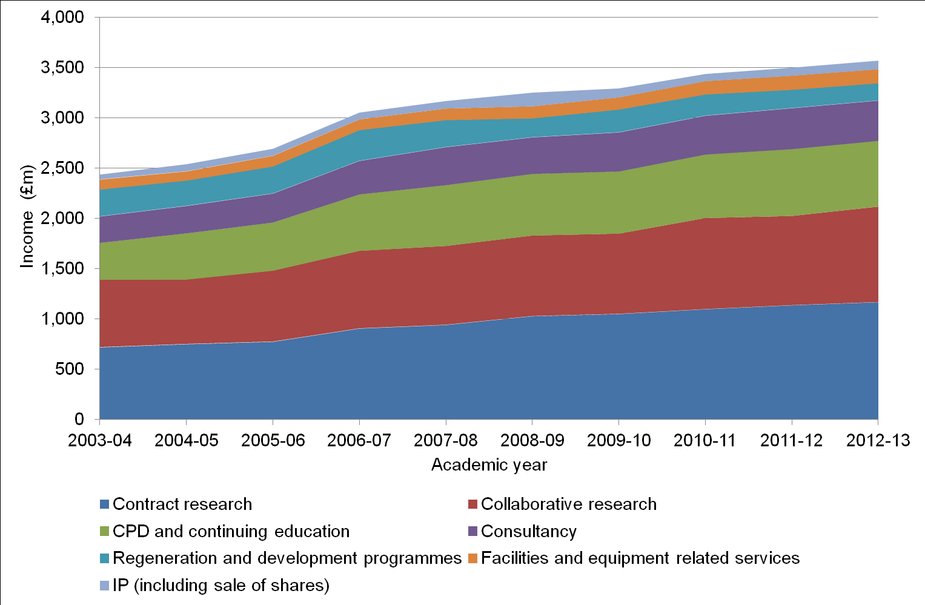
Income from collaboration 2003-13 (real terms)

Slide 3
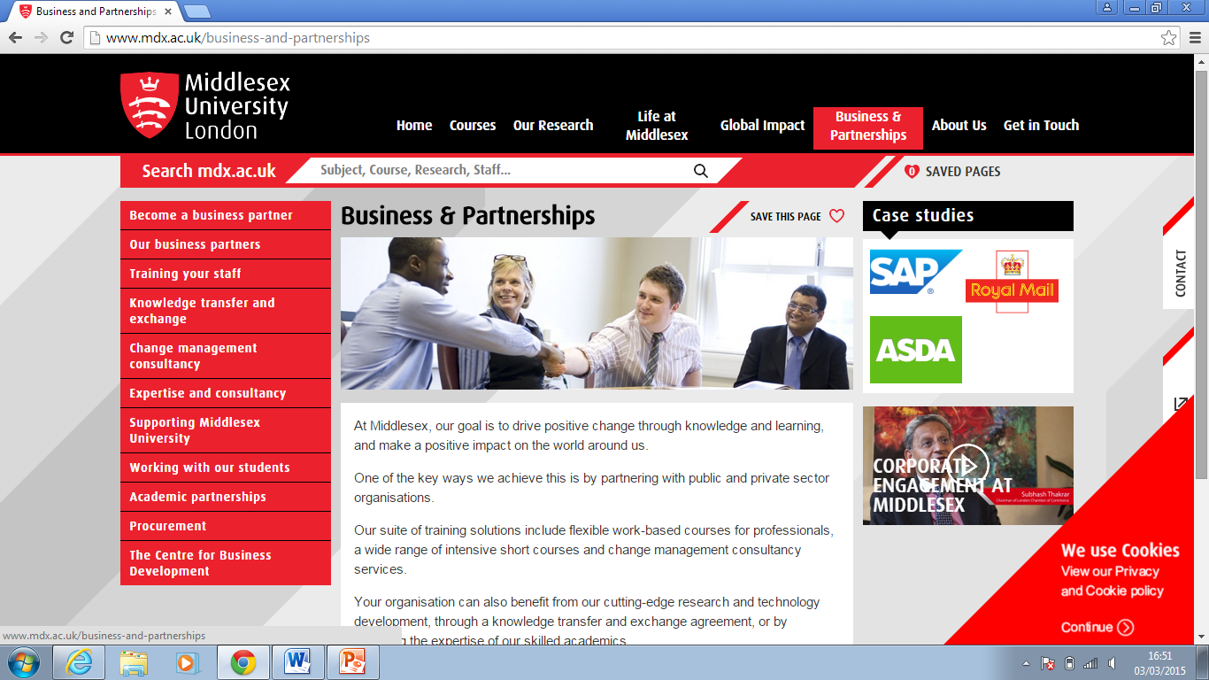
A front door for business
Notes:
Large bubbles are % of large businesses, small bubbles % businesses with fewer than 10 employees, using universities. Training, conferences and supervising are all more common than contract research.

Slide 4
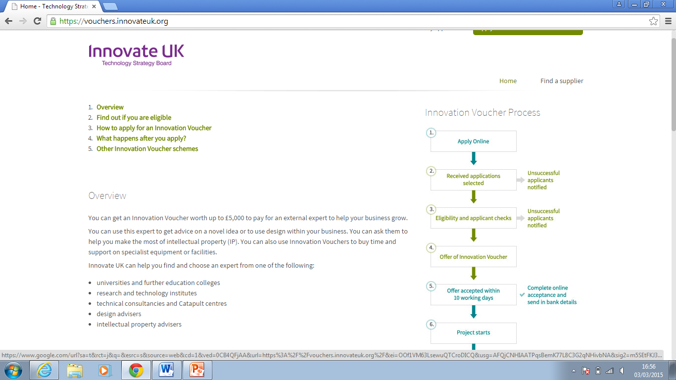
Innovation Vouchers
Notes:
Large bubbles are % of large businesses, small bubbles % businesses with fewer than 10 employees, using universities. Training, conferences and supervising are all more common than contract research.

Slide 5
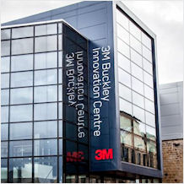
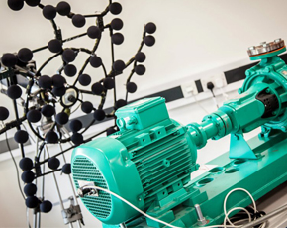
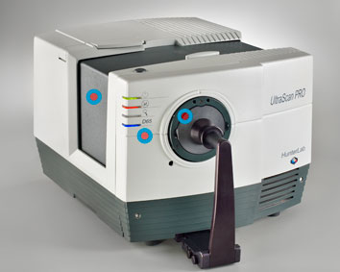
Shared space
Notes:
Large bubbles are % of large businesses, small bubbles % businesses with fewer than 10 employees, using universities. Training, conferences and supervising are all more common than contract research.

Slide 6
Catapult Centres
Cell Therapy Catapult (https://ct.catapult.org.uk/)
High Value Manufacturing Catapults (https://hvm.catapult.org.uk/)
Offshore Renewable Energy Catapult (https://ore.catapult.org.uk/)
Satellite Applications Catapult (https://sa.catapult.org.uk/)
Digital Catapult (https://digital.catapult.org.uk/)
Transport Systems Catapult (https://ts.catapult.org.uk/)
Future Cities Catapult (https://futurecities.catapult.org.uk/) in London
Notes:
Large bubbles are % of large businesses, small bubbles % businesses with fewer than 10 employees, using universities. Training, conferences and supervising are all more common than contract research.

